Slide 1

Respecting
the child
A mandatory
mission
Dr. Gilles Julien, MD, social pediatrician
Vancouver 2016

Slide 2
A silent epidemic
from the notion of «new morbidities»
to the cumulative effect of toxic stress
to the concept of multiple trauma
To ACE (adverse childhood experiences)

Slide 3

TOXIC STRESS
That makes children falling into the craks
Contaminated and unsafe housing
Disadvantaged environment
Lack of parental and societal stimulation
Malnutrition (fast food)
Lack of identity, reference and parental guidance
Poor attachment
Cultural breakdown and lack of a protective circle
Violence
Social Exclusion
No citizenship
Financial insecurity
Inadequate school ressources
wrong diagnosis
No resiliency
Failures and exclusions
Unmet fundamental needs ans rights
POWERLESS FAMILIES
DISENGAGED COMMUNITIES
IMPOVERISHED SOCIETIES
© All rights reserved, Fondation Dr Julien 2016

Slide 4
Polytraumatic experiences
The child experiencing multiple negative events along its developmental pathway will suffer in different ways:
an uncontroled effect on brain developement and brain control
Brain structural changes and epigenetic modification that leads to altered cognitive and emotional development
Major impacts on developement, behaviour, learning, adaptation
An arising specific toxic effect named
and subsequent possible mental deterioration

Slide 5
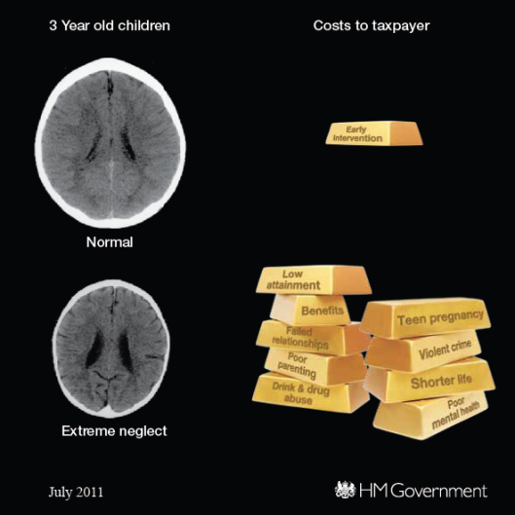
© All rights reserved, Fondation Dr Julien 2016

Slide 6
Net result when Non respecting children
Catastrophic impact on the right to be born and raised healthy and equal
Huge consequences on the global development particularly in the first years of life
Severe impact on the capacity to enter school ready to learn at 5 y.o.
Increased risk of significant diseases on the long run
Higher rates of negative behaviours
Highly diminished chance to succeed in life
Lesser life expectations

Slide 7
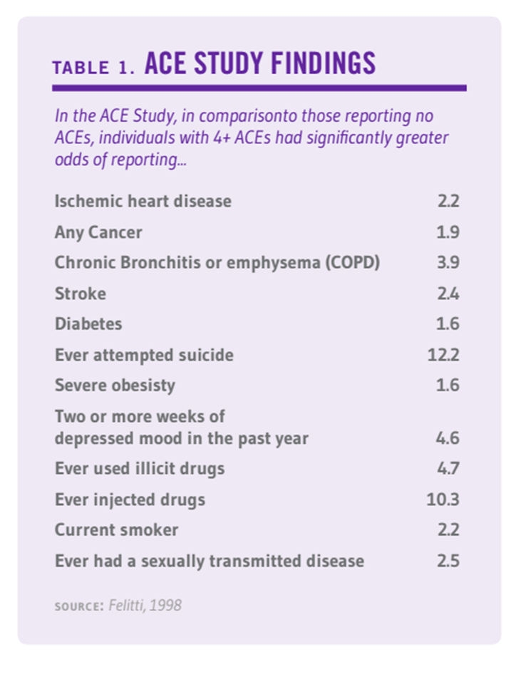

Slide 8
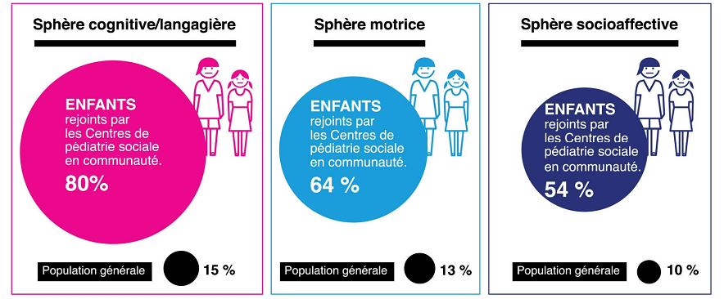
Who is our Population?
Compared with general population, there are five times more children (0-5 years-old) in CSP centers showing a developmental delay in at least one of the following:
Cognition and language
Motor development
Emotions and affects
80% of children
64% of children
54% of children
General population
General population
General population
General population
Notes:
L’infographie indique les domaines de retard de développement, dans les bulles, on observe le pourcentage d’enfants rejoints par la PSC comparativement à la proportion d’enfants souffrant de ce retard dans la population générale.

Slide 9
HOW TO PREVENT The silent EPIDEMIC ?
Respecting the UN Convention on
the Rights of the Child
Rights regarding physical needs:
    Adequate shelter & housing
    Health care
    Clean water & sanitation
    Protection from environmental pollution
    Adequate food
    Adequate clothing
    Protection from violence, exploitation and abuse
    (Adapted from P.A. Gorski)

Slide 10
HOW TO PREVENT THIS EPIDEMIC ?
Rights regarding social, economic and cultural needs:
    Knowledge of and respect for own language, religion and culture
    Stable economic environment
    Recognition of and respect of emerging competencies
    Access to appropriate guidance and support
    Access to play and friendship
    Respect for privacy
    Freedom from discrimination and prejudice
    (Adapted from P.A. Gorski)

Slide 11
HOW TO PREVENT THIS EPIDEMIC ?
Rights reagarding intellectual, psychological and emotional needs:
    Stable and loving family environment
    Access to education
    Access to age appropriate information, stimulation and opportunities to be listened to and taken seriously
    (Adapted from P.A. Gorski)

Slide 12
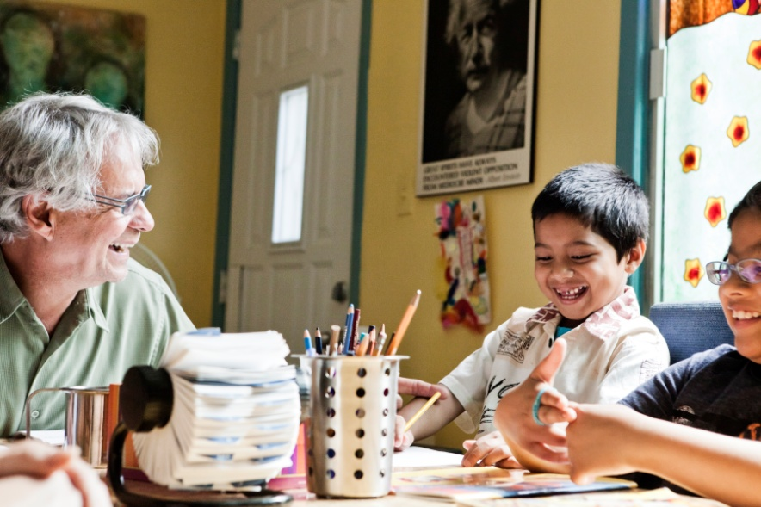
Building a new paradigm of care and services
to respect the integrity of the child
Creating a movement around children and their families to ensure their optimal development. It implies active participation of the child, the family and other significant people in their lives in the aim to control toxic stressors. The community-based structure leverages interventions and facilitates resilience factors.
© All rights reserved, Fondation du Dr Julien 2016

Slide 13
A New Medical Paradigm
The sources of social medecine:
  Consider health and development as a whole
  Consider various environments (home, school, neighbordhood, etc.)
  The importance of decoding the child
The need to take action at the community level:
  Assure children’s rights
  Prevent the consequences of toxic stressors and polytraumatic experiences on child development and well being
The need of a proximal and integrated interdisciplinary approach:
  A meeting point and cross-fertilization of various disciplines - [Michel Manciaux]
  Support vulnerable children and families
  Child global health approach in and with the community
The need to scale up:
  Training for professionals and students
  Collaboration with research: CSP Chairs McGill University and UdeM
  Certification process across Canada

Slide 14
Community social pediatric
(added value)
-Accessibility
-Intensity
-Tailored accompaniement (medical, legal,social)
-Cohesion-integration of services
-Advocacy for the repect of the child

Slide 15
COMMUNITY SOCIAL PAEDIATRICS CENTRE (CSPC) the link for the cohesion of services
Health
CPSC
Education
Fundamental needs
Social services
Health determinants
Justice
Children’s rights
Culture and Leisure
Environment

Slide 16

Indicated Care And Services
The know how to be: an approach
of proximity with specific attitudes and complete respect (eg “bedside manners”)
The know how: a comprehensive approach based on scientific
evidence and interdisciplinary knowledge:
The know how to care:
EEDA approach

Slide 17

Children’s Needs
Stability
Security
Competence
Physical
Emotional
Children’s
Needs
Balance
Social
Mental
Cultural &
Spiritual
Identity
Motivation

Slide 18
EEDA Approach
Establishing. Getting to know each other, starting to feel comfortable with each other.
Exchanging. Sharing issues, information, common goals with the child, the family and intervenors of multiple sectors.
Decoding. Understanding the roots of symptoms, the origins of suffering and the causes of diseases and new morbidities.
Action. Developing a shared and priorized action plan.

Slide 19
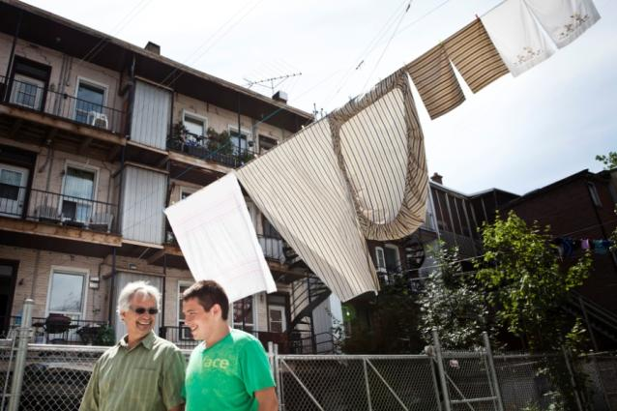
COMMUNITY SOCIAL PEDIATRICS
«The Montreal model»
A model that engages the community with the common goal to attain the well-being of all children in a perspective of equity
A call to action for high risk children within high risk families and environments
A specific approach to make sure that children’s rights are all respected in a specific community

Slide 20
Factors For Success When Supporting Vulnerable Children
Building a network around the child, a protective and caring circle within the community, and accessible global care.
Creating a community-based structure to leverage interventions and developing resilience factors for both the child and the family
Promote an EEDA approach.
Defining a concerted action plan for consistent services and involvement of the child, the family networks and the different systems and sectors (stakeholders).
Cooperation of trained professionals to take into account the complexity of the procedure and to ensure the respect of all of the child’s fundamental rights.
Promote a broad funding model (population, private, government)
Promote a university-based association for training and research
© All rights reserved, Fondation Dr Julien 2016

Slide 21
Output: Social Capital And Well-being Of All Children
RESULTS
Creates strong mobilization of families and community members around the children’s fundamental rights
Contributes to the evolution of professional competences and the envisioning of a fair and sustainable society
Encourages better practices (evolution and envisioning) and institutional systemic changes on how to reach children living in a stressful environment as well as alleviating sources of toxic stress
© All rights reserved, Fondation Dr Julien 2016

Slide 22
RESULTS
Drastically reduces the cost of intervention associated with stressful living conditions
Efficiently addresses sources of toxic stress
Offers children living in stressful environments a better chance to develop their full potential
Increases accessibility to coherent health, social and legal services to untrusting families
© All rights reserved, Fondation Dr Julien 2016

Slide 23
Measurable Outcome Of The Model
Accessibility to diagnosis and global health care for children from disadvantaged neighborhood.
  Geographic proximity
  Relational proximity
Integration in a single location of medical, specialized, psychosocial and legal services, which provides a global response to a wide range of children’s and families’ needs.
  Multiple interdisciplinary and intersectorial professionals in the same location
Strong collaboration with different sectors.
  Education;
  Socail services, etc.
Improvement of family well-being after one year of services in a CSP center.
  Improvement in children’ social-emotional development
  Improvement in parent-child relationship
  Sense of social support enhanced
Prevention of parental neglect and improvement in child-parent attachment
  Significant number of children staying in their family settings
  Positive changes in parenting skills and self-confidence
  CSP center seen as a positive presence in their family environments
Clément et al., 2014; Marcoux, 2010
© All rights reserved, Fondation Dr Julien 2016
Notes:
Selon les résultats démontrés par l’étude GRAVE et le rapport sur le programme de Maltraitance (Marcoux 2010).

Slide 24

BUILDING STRONG CHILDREN
“It is easier to build strong children
than to repair broken men.”
- Frederik Douglass
© All rights reserved, Fondation Dr Julien 2016

Slide 25
REFERENCES
Clément M. et coll. (2009). Proximités : liens, accompagnement et soins. Presses de l’université du Québec, p. 125.
Darbellay F. (2005). Interdisciplinarité et trans-disciplinarité en analyse des discours. Complexité des textes, intertextualité et transtextualité. Genève : Slatkine, p. 1 -404.
Eisenberg D. (2002). À l’aube d’une médecine intégrée, Congrès international sur la science du touché, Montréal, entrevue de Christian Lamontagne sur PasseportSanté.net consulté le 10 juillet 2013.
Garner A.,Shonkoff J. (2012). Early Childhood, adversity, Toxic Stress, and the Role of the Pediatrician: Translating developmental Science Into Lifelong health, Pediatrics,Pediatrics, Vol. 129-1, e224-31
Julien, Gilles (2004). Soigner différemment les enfants – L’approche de la pédiatrie sociale. Montréal : Les éditions logiques. 1-287.
Julien, G. et H. Trudel. (2009). Tous responsables de nos enfants : Un appel à l’action. Montréal : Bayard Canada. p. 1-266.
Shonkoff J.P., Siegel B.S, Dobbins M.I, Earls M.F., Garner A.S., McGuiinn L., Pascoe J., et Wood D.L. (2011). Early childhood adversity, toxic stress and the role of the pediatrician: Translating developmental science into lifelong health. Pediatrics, doi:10.1542/peds.2011-2662.
Lebeau A., Vermette G. et Viens C. (1997). Bilan de l’action intersectorielle et de ses pratiques en promotion de la santé et en prévention des toxicomanies au Québec. Ministère de la Santé et des Services sociaux, p . 1-126.
Lesemann F. (2011), Social Innovation, Informality and Social Science, Intl Conf on Indicators and Concepts of Innovation, Vienna, p.1-7.
OCDE (1972). Interdisciplinarity: Problems of teaching and research in Universities, Paris: OCDE.
Presseau A. (sous presse). Référentiel de compétences de la pédiatrie sociale en communauté.
Social Medecine (2007). Abstracts from the Social Medicine session at the 2006 annual meeting of the American Association of Medical Colleges. Seattle, Volume 2, No1, p-56-64.
Solar O. et coll. (2009). Moving Forward to Equity in Health: What kind of intersectoral action is needed? An approach to an intersectoral typology. Presented at the 7th Global Conference on Health Promotion. “Promoting Health and Development: Closing the Implementation Gap”, Oct. 26-30, Nairobi, Kenya.
Dong, M., Giles, W. H., Felitti, V. J., et al. (2004). Insights into causal pathways for ischemic heart disease: Adverse Childhood Experiences study. Circulation,110 (13),1761-1766.
Clément, M.È., Moreau, J., Gendron, S., Lavergne, C., Turcotte, G., Piché, A.-M., Bérubé, A., Gagné, M.-H., Alain, M., Hassan, G., De Montigny, F., St-Amand, A., & Léveillé, S. (2014). Regard mixte sur certaines particularités et retombées de l'approche de la pédiatrie sociale telle qu'implantée au Québec et sur son intégration dans le système actuel des services sociaux et de santé. Rapport de recherche final. Québec : MSSS et Fonds de recherche du Québec – Société et culture (actions concertées), 195 p.

Slide 26
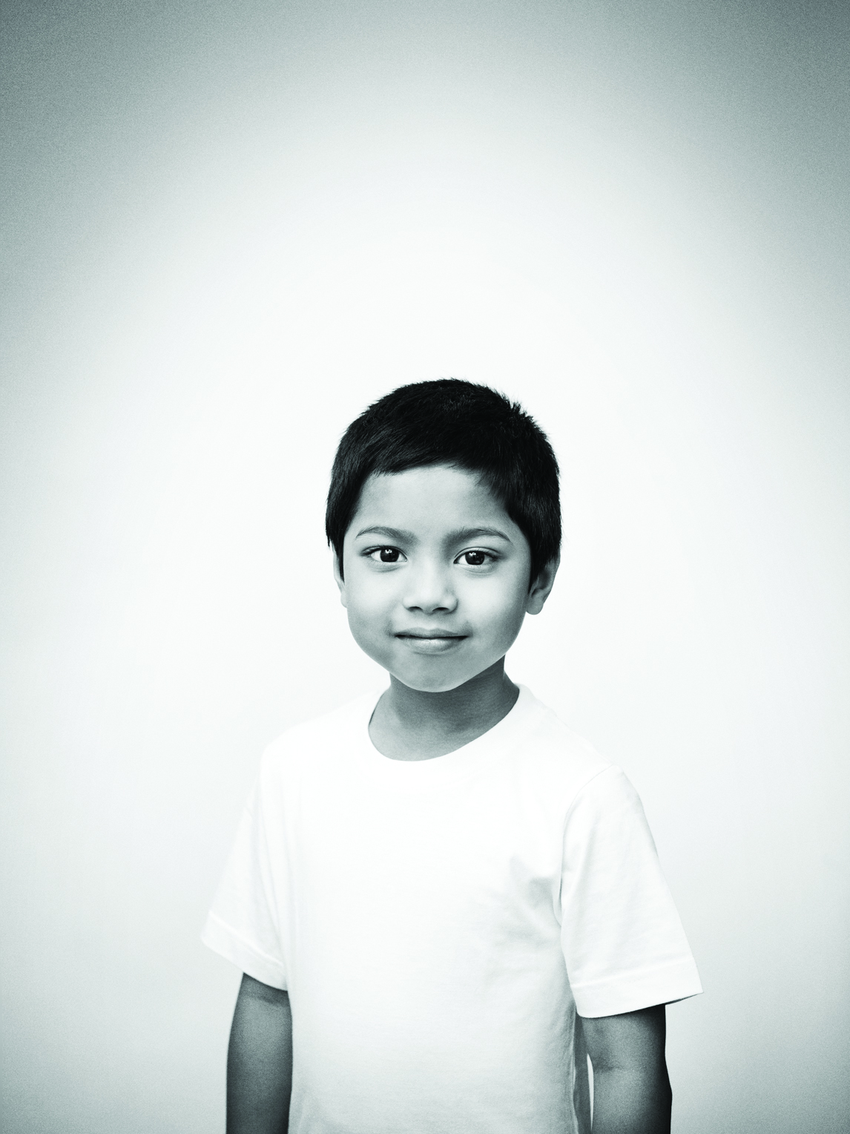



THANK YOU!
fondationdrjulien.org
knowledge transfer portal: http://pediatriesociale.fondationdrjulien.org/
FondDrJulien
Fondation du Dr Julien
Fondation du Dr Julien

